Slide 1
Clock Domain Crossing, Why Should I be Concerned?
Dominic Lucido
Technical Account Manager
Rick White
Application Engineer Consultant
December 2019

Slide 2
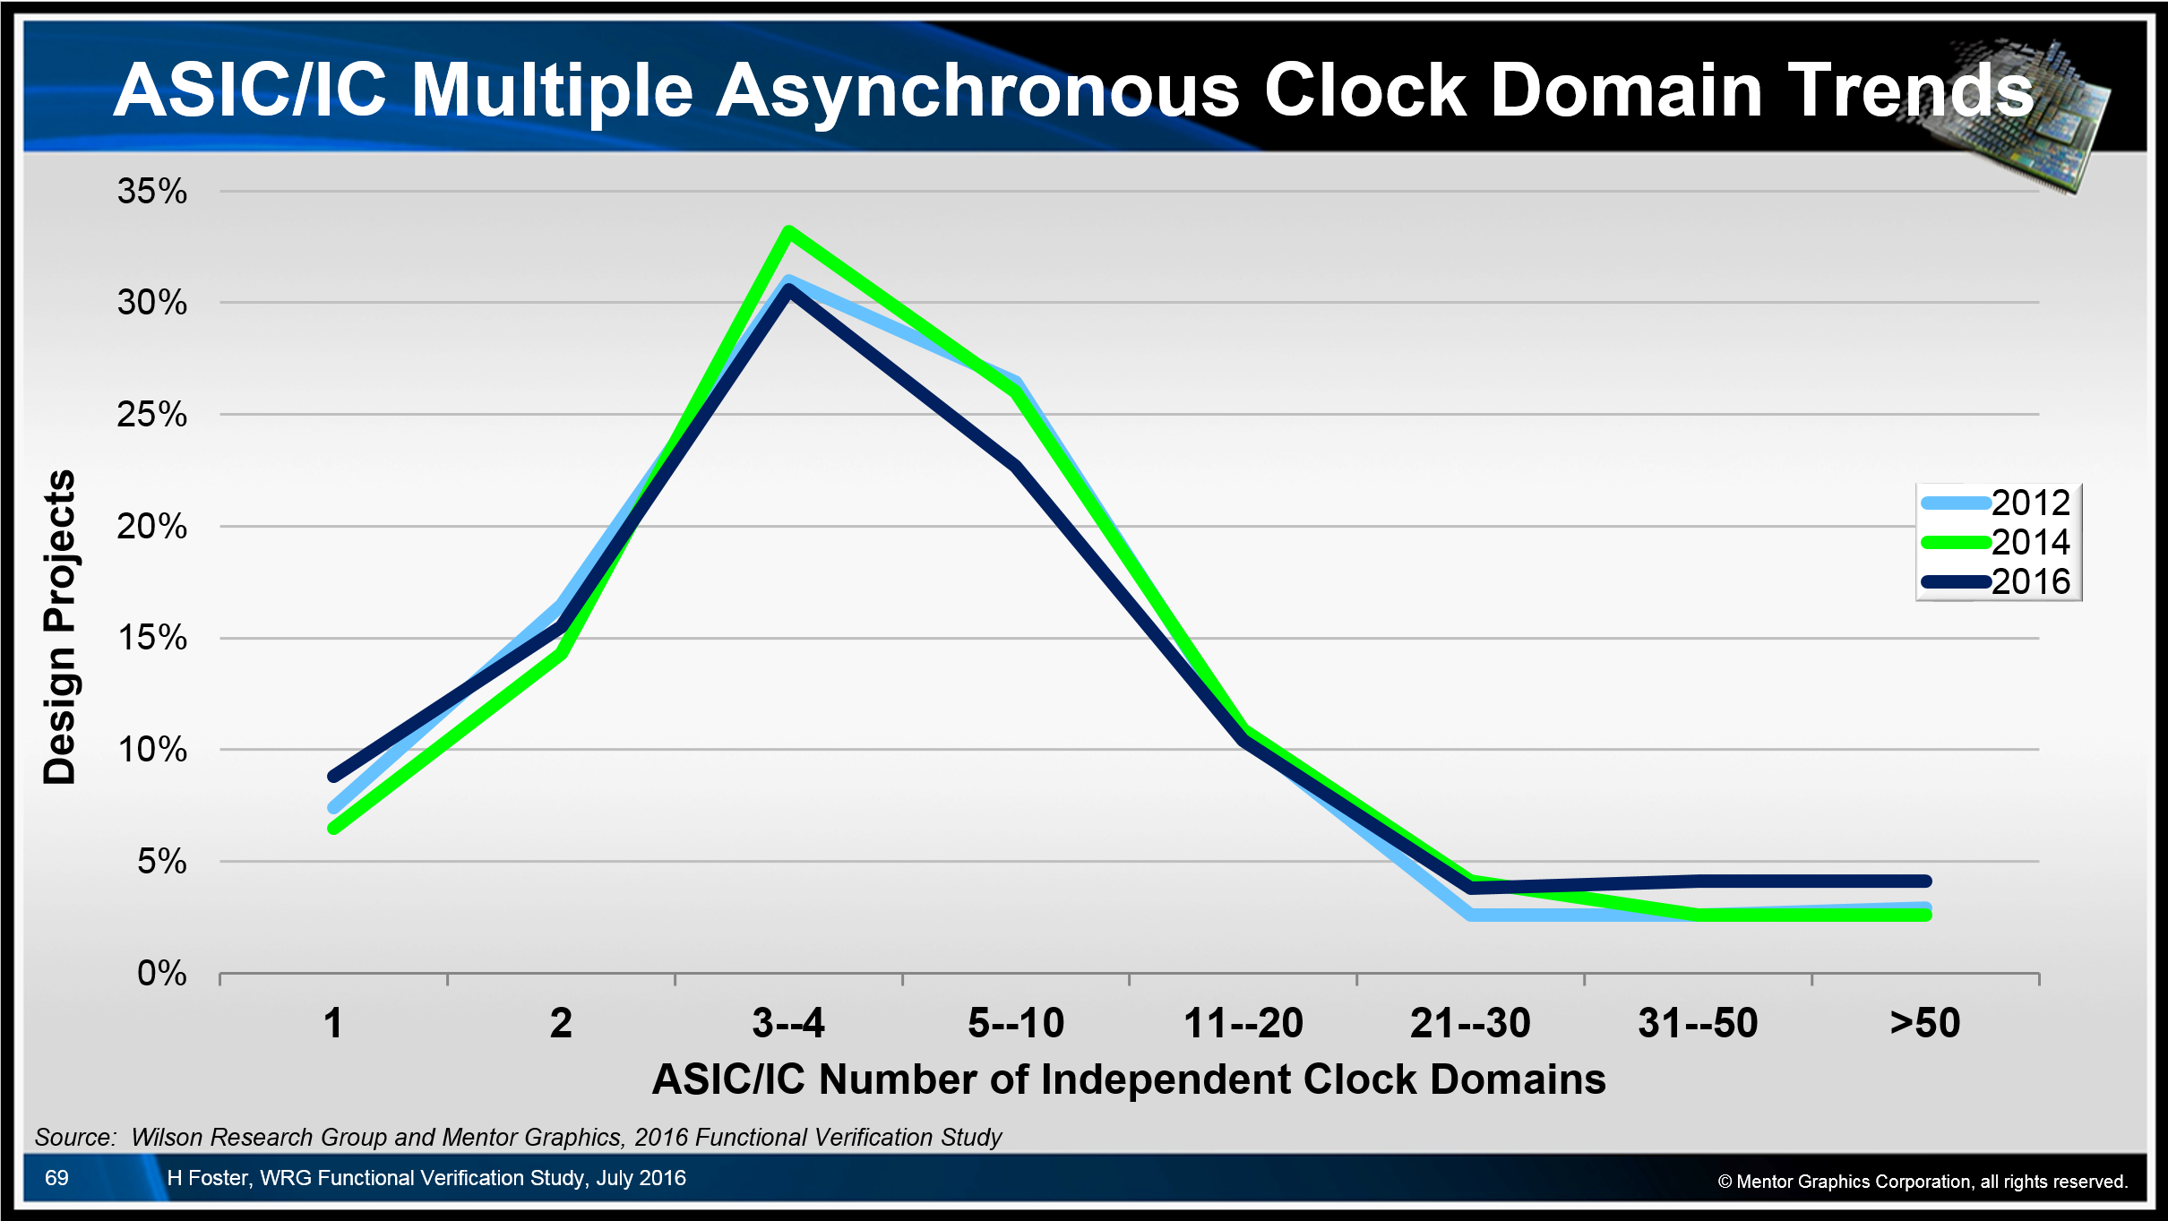
Why CDC Verification is a Growing Problem: 10 or More Independent Clock Domains are Common

Slide 3
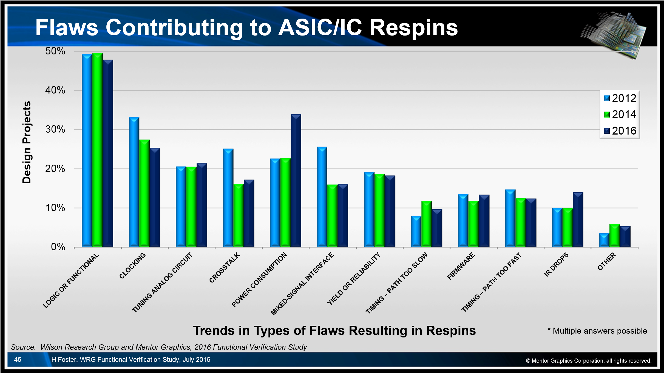
1 in 4 ASIC Re-spins are Caused by Clocking Bugs

Slide 4
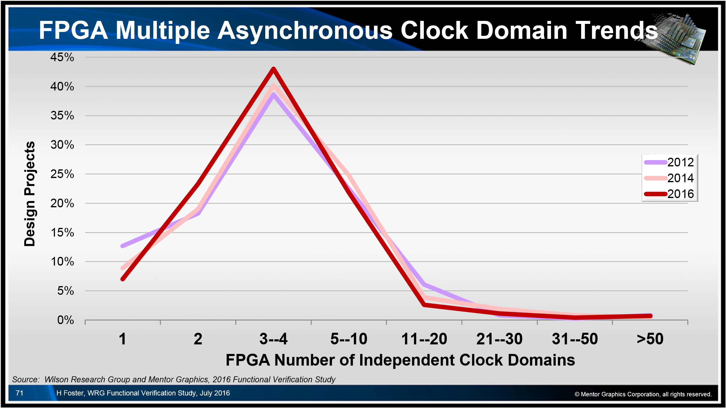
Why CDC is a Growing Problem for FPGA Designers: 4 or More Independent Clock Domains are Common

Slide 5
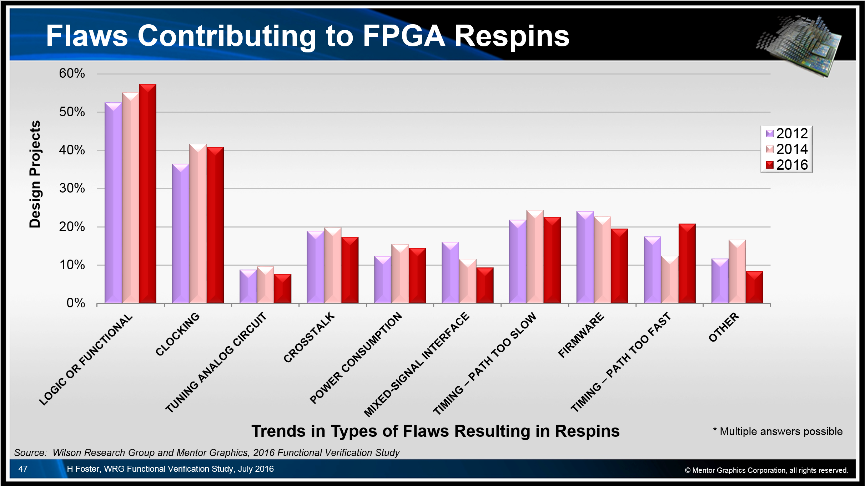
Even FPGA Users Are Suffering from Clocking Bugs

Slide 6
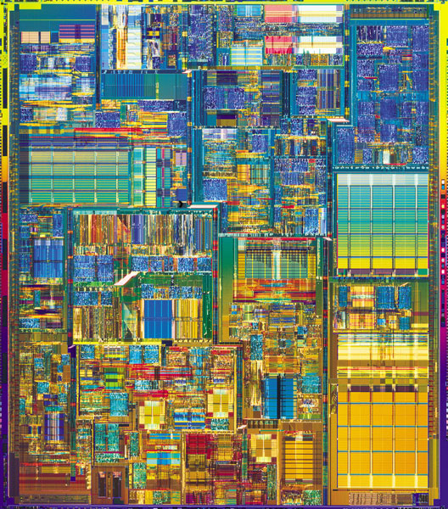
Today’s Design Characteristics
USB PHY
Ethernet PHY
PHYs
PHY
Processor cores
DSP cores
Many IP blocks
Sophisticated interconnects
Multiple bus bridges
Advanced power management
CPU
DSP
USB
Controller
Ethernet
Protocol
Custom
Core
Front-end
Master IF
Master IF
Slave IF
Master IF
Master IF
Slave IF
Arbiter
AMBA AHB/AXI
Master IF
Master IF
Bridge
Bridge
Memory
DMA
Custom
Core
Back-end
AMBA AHB
PCI-Express
Main Clock Domain
Slave IF
Slave IF
UART
GPIO
PCI-E PHY
Power-Management,
Clock, Reset, Test, Analog
Many Asynchronous Clock Domains

Slide 7
So, What’s The Problem With Clocking Signals?
To transfer signals from one clock domain to another, you need clock-domain crossing (CDC) logic
Clock-Domain Crossing signal
Logic
Logic
Tx
Rx
A
Clock domain A
B
Clock domain B
You CANNOT avoid violating setup and hold timing conditions in this logic

Slide 8
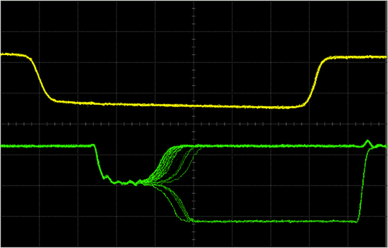
Why are we here?
Multiple clock domains interconnected w/out “synchronizing” will scramble clock signals
If a clock signal is “metastable” the chip can’t run → Re-spin!
1 in 4 FPGA re-spins are caused by CDC Bugs

Slide 9
Why do YOU need to worry about CDC?
Re-convergance
Protocol checking
Metastability

Slide 10
Reconvergence
CDC signals cross from one domain to another with an assumed relationship
Can be combinational, sequential, or deeply sequential
Unpredictable delays on CDC paths lead to reconvergence errors
Designs need logic to correctly handle reconvergence
Can occur on single-bit or multiple-bit signals
tx_d0
Sync 0
S2
FSM Input
S1
Sync 1
tx_d1
Grey Encoder
Sync 1
Grey Decoder
tx_d2
Sync 2
S3
S4
0 0 0
1 1 1
1 1 1
0 0 0
0 1 0
0 1 0
0 0 0
0 0 0
0 1 0
0 0 0
1 0 1
1 1 1
0 0 0
0 0 0
1 1 1
Invalid Command
Valid Command – but delayed

Slide 11
Design for Reconvergence
Apply
Command
To Wrong
Data
Asynch
FIFO
Apply
Command
to
Data
data
data
id
id
valid
==
Asynch
FIFO
cmd
cmd
ID Comparator ensures that data and command
are aligned prior to processing

Slide 12
Single-Bit Reconvergence
cdc_d
rx_q
tx_d
tx_clk
rx_clk
cdc_d
rx_q
rx_clk
rx_clk
Metastability delays destroy
correlation between two transitions
Notes:
In this example, we will look at another type of reconvergence, one that occurs in “time”.
In this example we are transferring a signal between domains. The receiving domain assumes that whenever this signal goes high, it will remain high for a minimum of 2 cycles.
As the signal is transferred, one of the edged (the falling edge) triggers a metastability event due to a setup violation, and the hardware settles to a random zero. This means that the hardware has advanced the edge (relative to simulation) by one cycle.
The end result is that in the receiving domain the signal is now no longer high for the duration expected and the relationship between the edges has been destroyed leading to a potential problem.
Both of these types of reconvergence problems “space” and “time” can be fixed through good design.

Slide 13
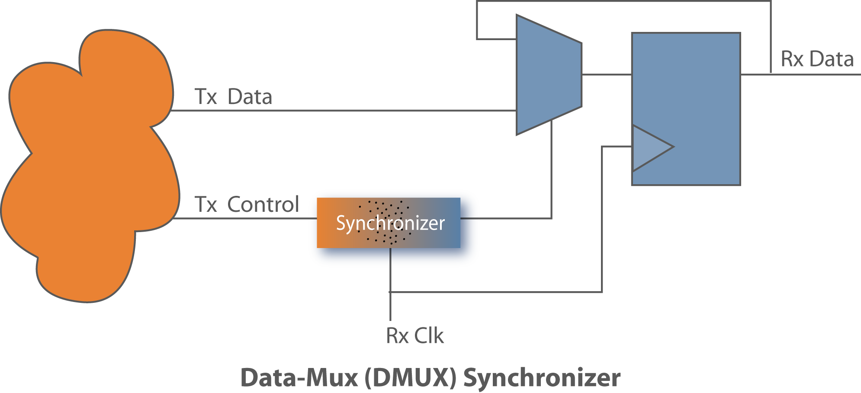
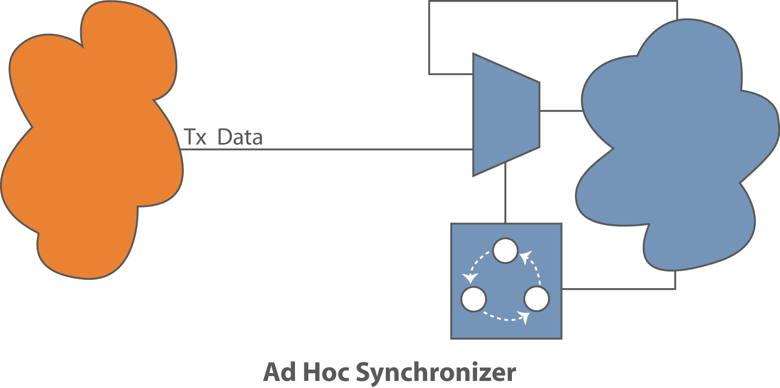
CDC Transfer Protocols
Synchronization structures require a transfer protocol
Ensures data is predictably transferred between domains
These protocols must be verified
When protocol is violated
Data is lost or corrupted
Metastability may occur
Simulation may not show a failure
Silicon will eventually show a functional error

Slide 14
Metastability Is Not Detected by RTL Simulation
Simulation captures a ‘1’ while silicon produces either a ‘1’ or ‘0’
Simulation captures a ‘0’ while silicon produces either a ‘1’ or ‘0’
CDC signals are subject to metastability when timing violations occur
Image source: http://www.fpga-faq.com/Images/meta_pic_1.jpg

Slide 15
CDC Paths Cause Metastability
When a CDC signal changes values between the setup or hold time of a receiving domain’s register
Receiving register becomes metastable
Settles to a random value, after unknown amount of time
Happens even with proper synchronization & protocols
Can cause significant functional problems in the design
Clock
D
Hardware Q
Data Sampled
Notes:
15

Slide 16
Metastability Happens
Every type of storage element is susceptible to metastability
It’s just a matter of time…
Can your design handle it?
f_{clk} = Clock Frequency
f_{in} = Input Signal Frequency
t_{d} = Duration of critical time window
Notes:
16

Slide 17
Manual ways to mitigate the effects of CDC
Using synchronizers
Ad-hoc coding styles to circumvent crossings

Slide 18
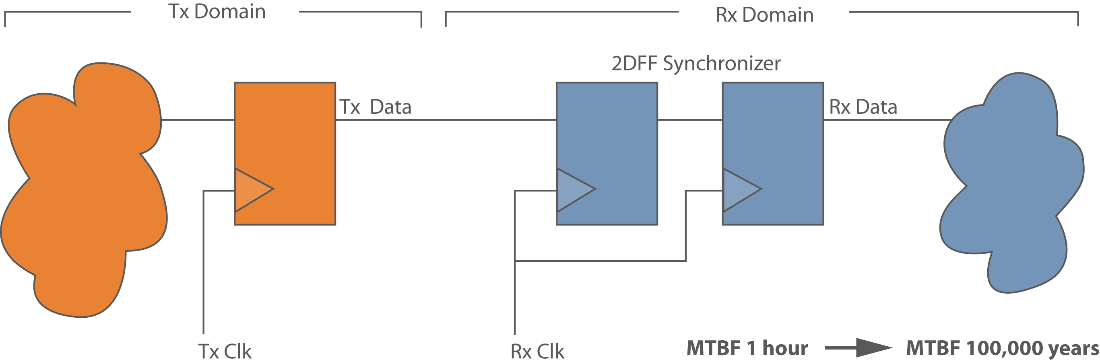
CDC Synchronizers
Designers add synchronizers to reduce the probability of metastable signals
Synchronizers are sub-circuits that prevent metastable values from being sampled across clock domains
Take unpredictable metastable signals and create predictable behavior

Slide 19
CDC Synchronizers (continued)
Many different synchronizer types
“Structured” and “Ad hoc”
Each synchronizer follows strict rules for that must be verified
But…
Synchronizers can only resolve unpredictable values
Synchronizers cannot resolve unpredictable delays
Glitch
Free
Output
Single
Point
Sampling
Full
Cycle
To Settle

Slide 20
Ad-Hoc methods
For multibit signals such as buses, the usual solution is to use a Gray code when crossing a clock domain boundary. A Gray code ensures that only a single bit changes as the bus counts up or down. This makes it possible to detect whether all bits have been captured together by the receiving clock or if they have been skewed across multiple clock cycles due to metastability or differing delays among the bus bits.
For example, in an asynchronous FIFO, the read and write pointers cross over to the write and read clock domains, respectively. These pointers are control signals that are flop-synchronized. The signals are Gray-encoded prior to the crossover.

Slide 21
Using automated solutions (Questa CDC) to uncover issues
Automated checking for proper use of Synchronizers
Automated checking of re-convergence
Seeing the effects of clocks when they go metastable

Slide 22
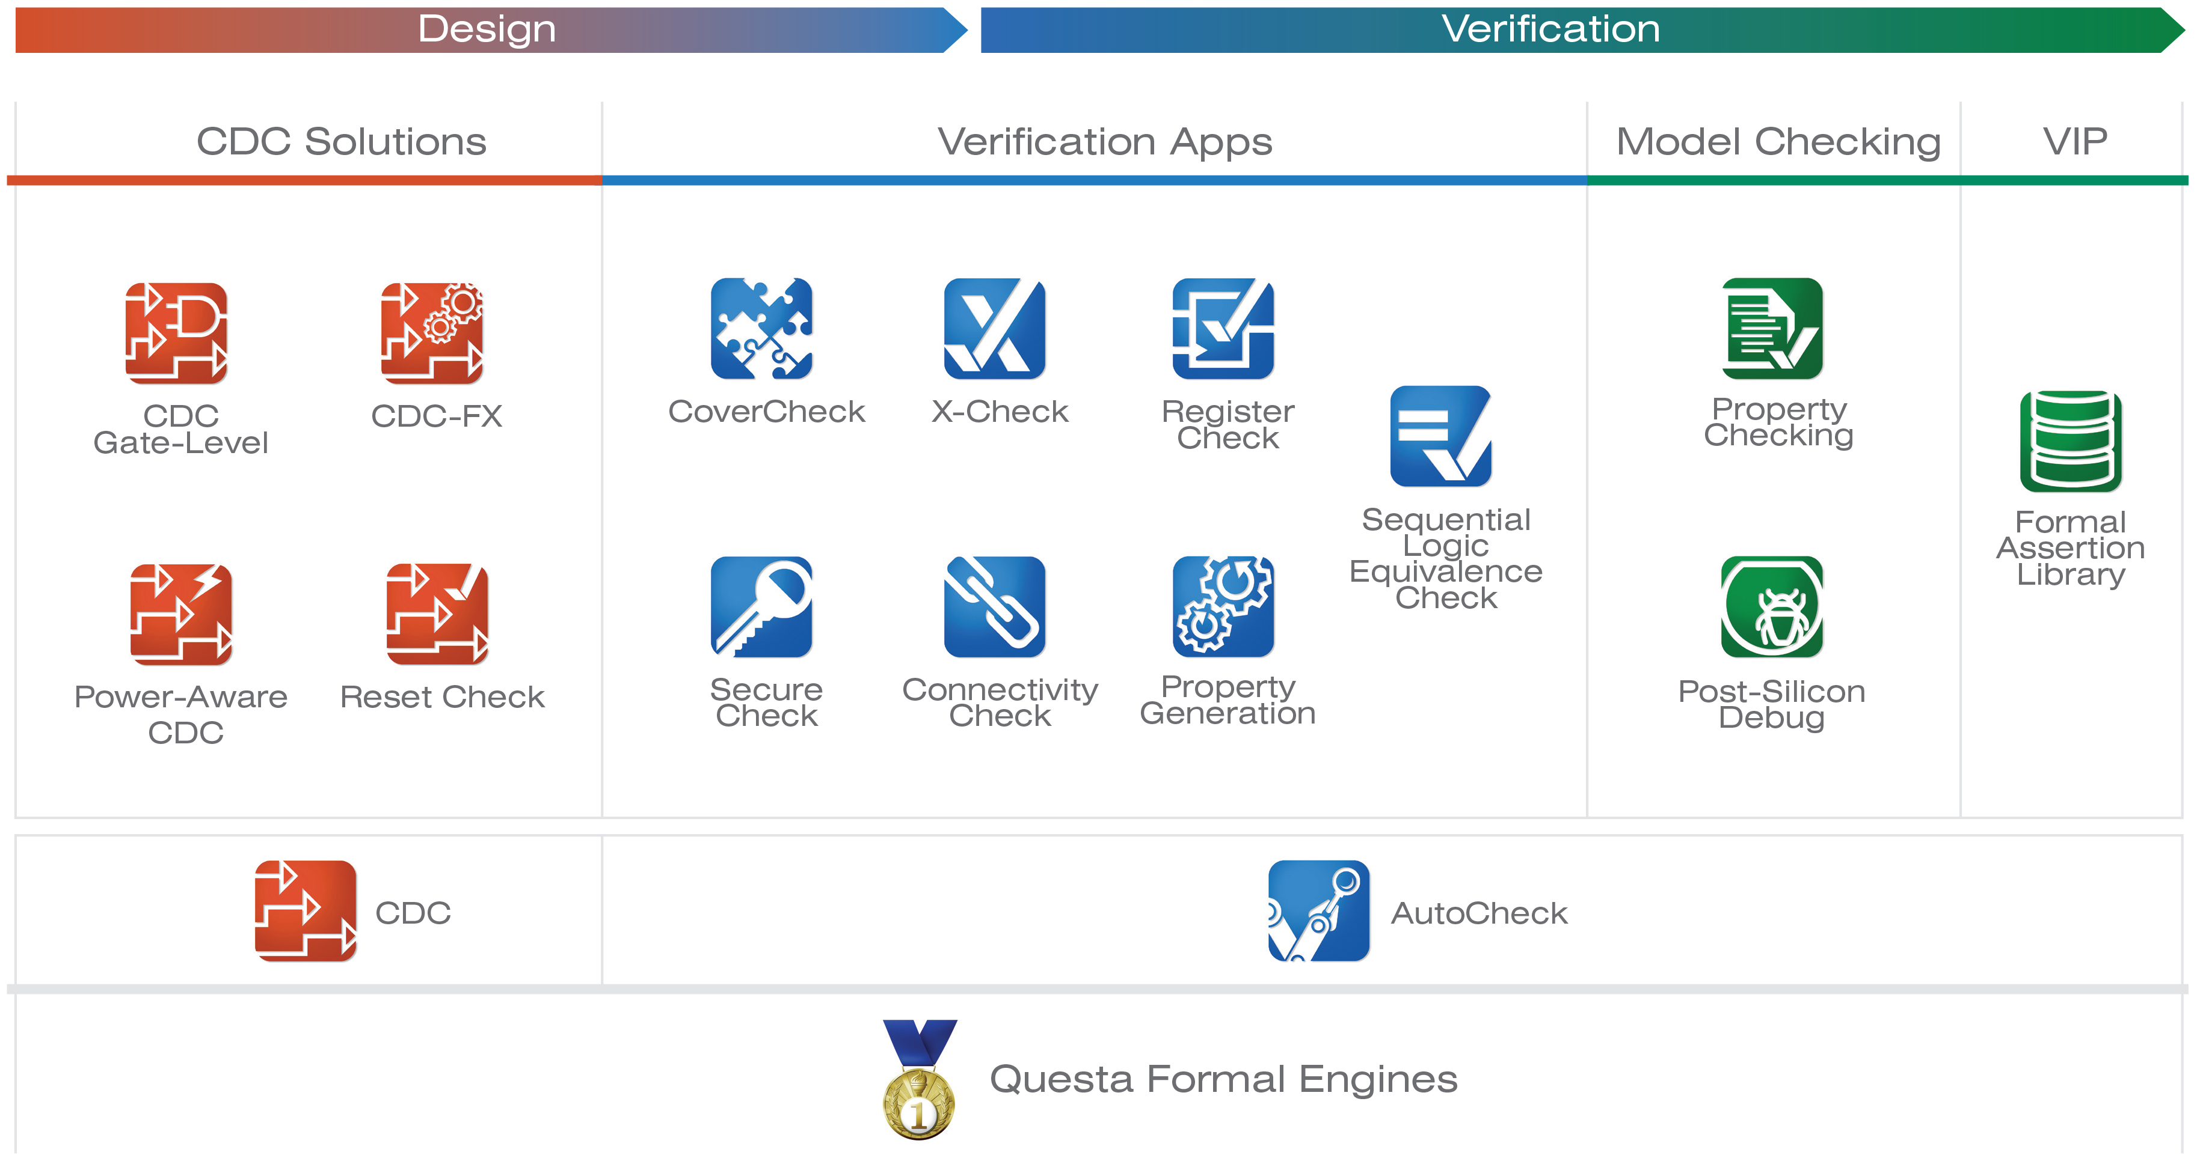
Questa Formal Solutions & Apps Automated, Exhaustive Verification For Complex Challenges

Slide 23
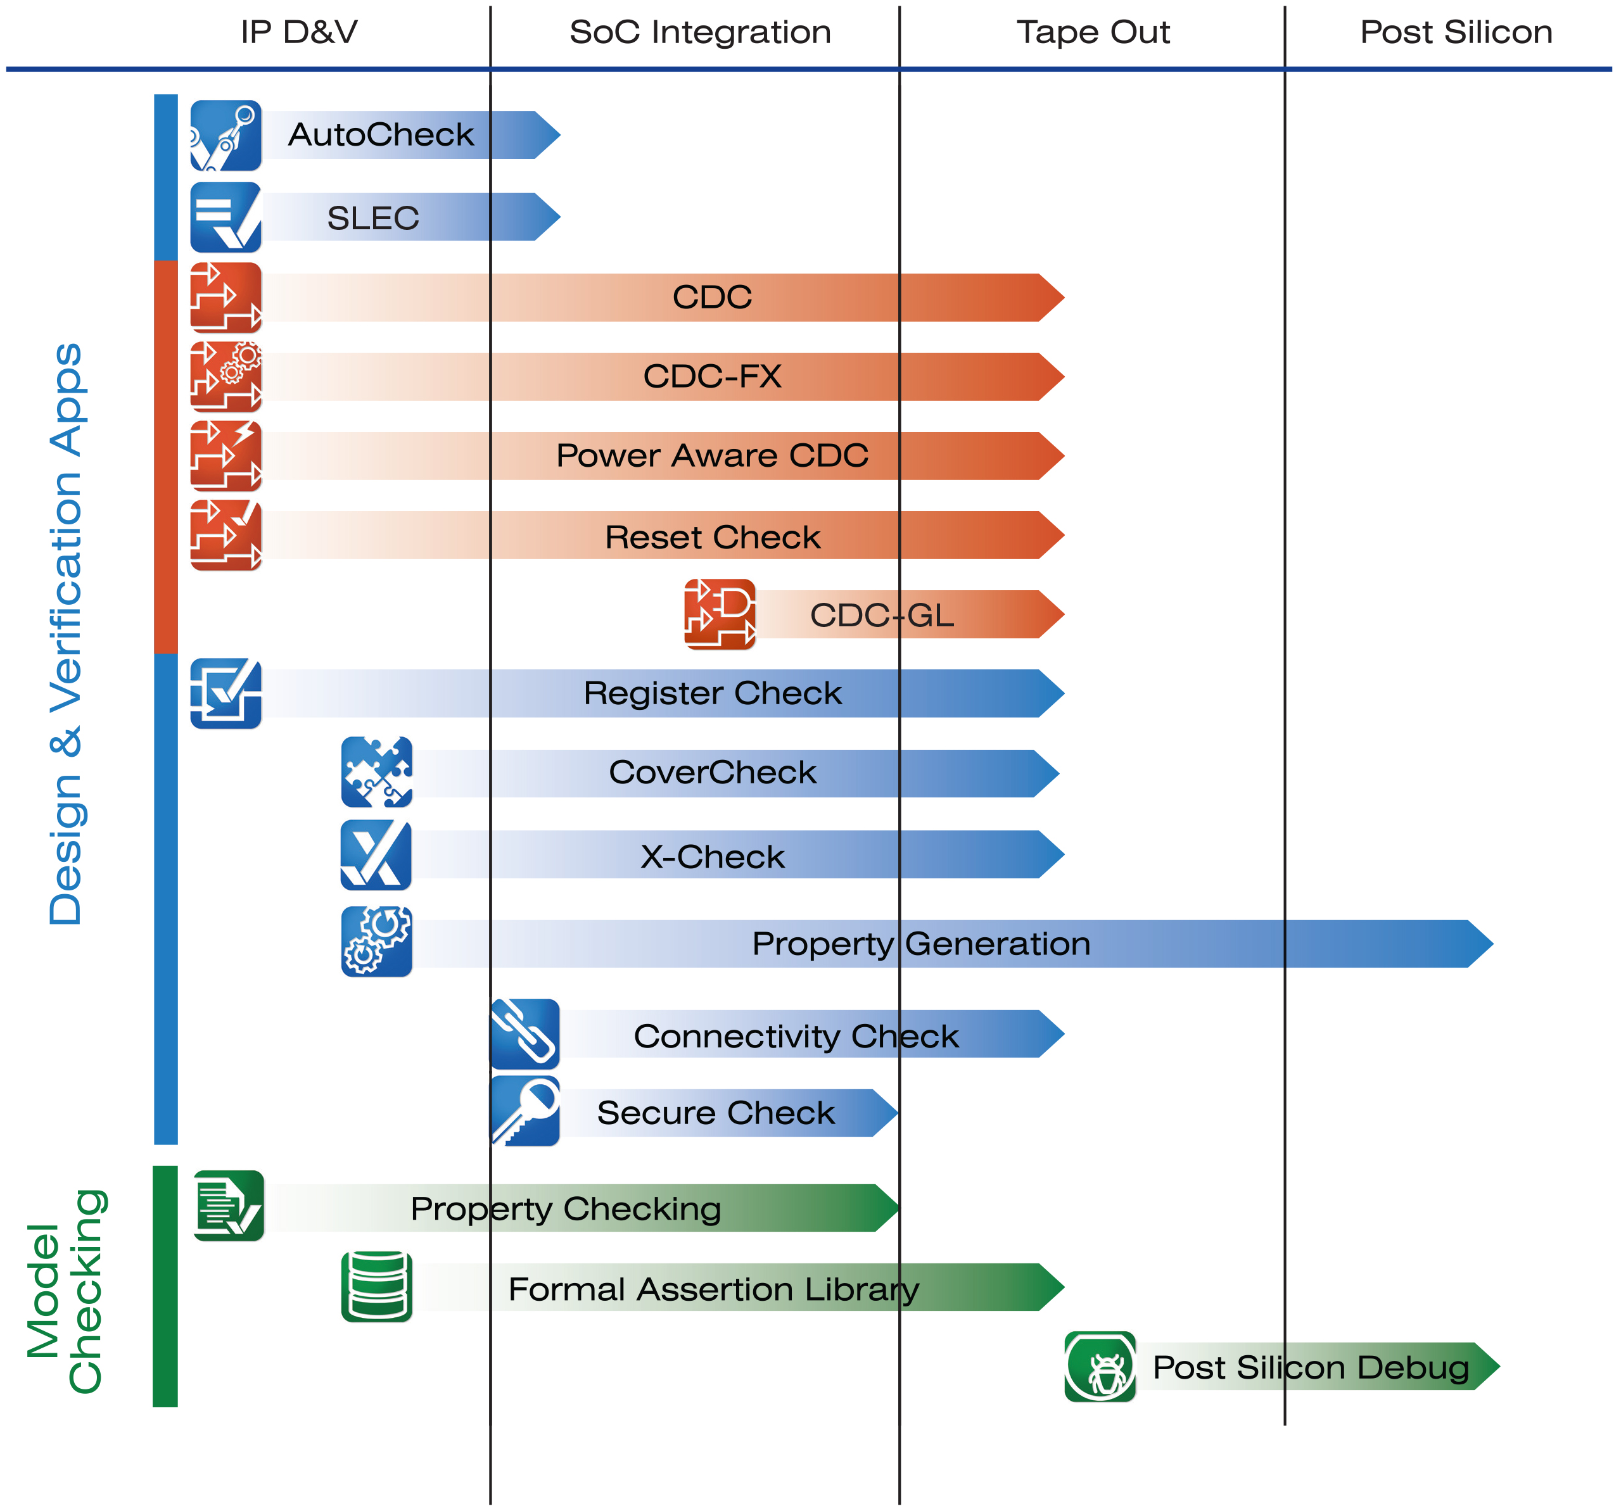
Questa Formal-Based Solutions & Apps Automated, Exhaustive Verification For Each Project Phase

Slide 24
What’s Driving Customer Adoption of Questa CDC?
Highest performance & scalability
Automated, thorough, hierarchical approach
Contextual guidance to leverage over 50 CDC schemes
Dynamic CDC analysis integrated with QuestaSim
UCDB from Questa CDC can be sent to Questa Verification Management to track progress over multiple runs

Slide 25

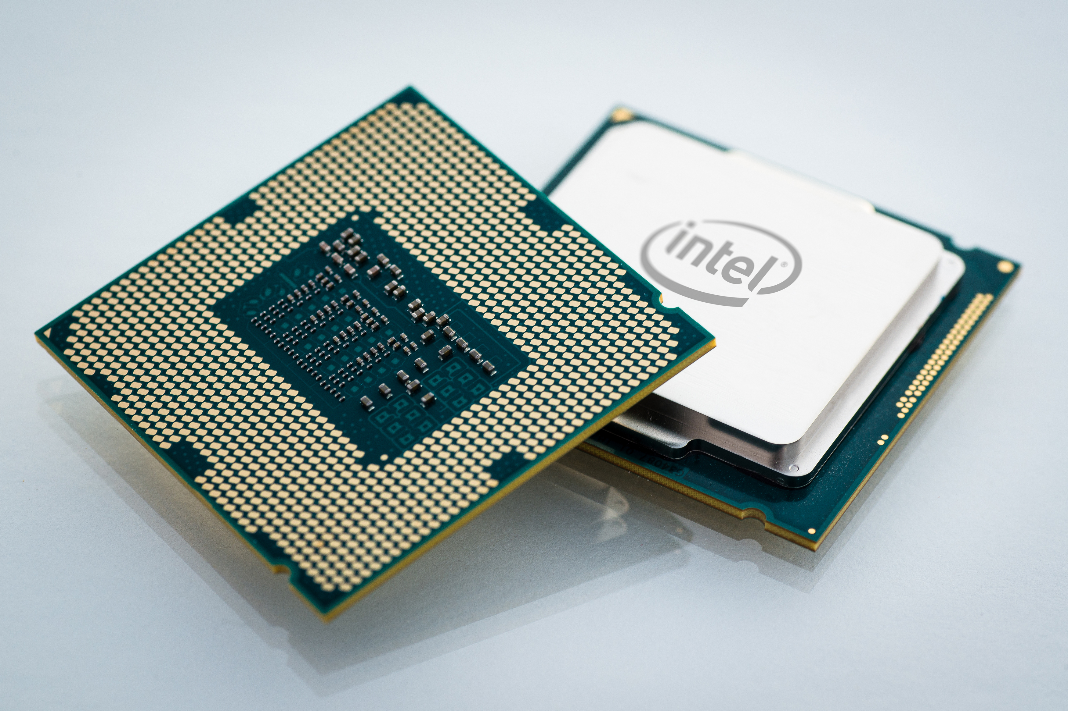

Questa CDC Advantages
Accuracy
Scalability
Guidance

Slide 26
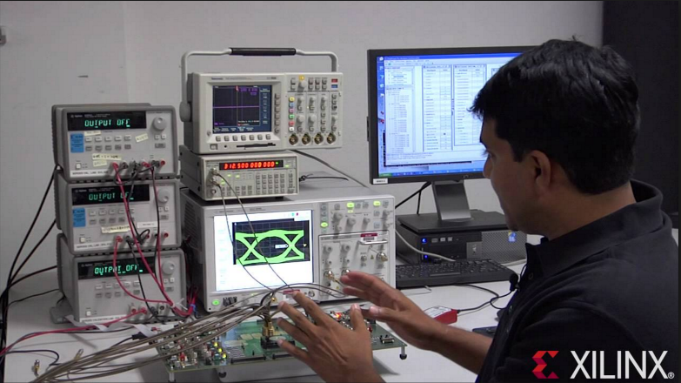
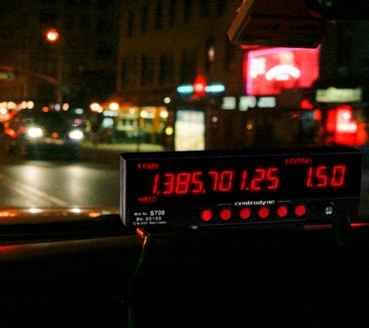




Questa CDC for FPGA Users
CDC bugs look like STA → CDC saves weeks of lab time!
MGC advantages: QoR, debug, corrective guidance
New Xilinx Vivado integration simplifies setup & run
Supported devices:

Slide 27
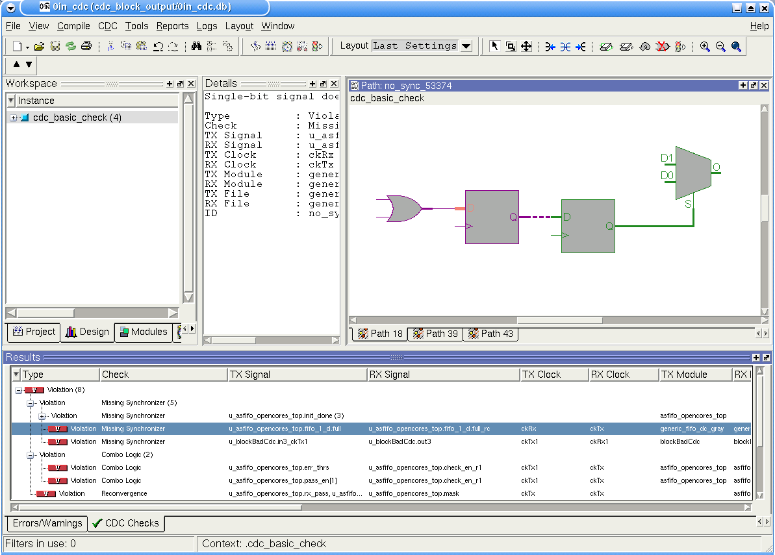



Enhancing the Questa CDC + FPGA Workflow
GUI-based work flow & reports
“CDC-FX” Metastability
models
for functional simulation
SDC
Questa
CDC
UCDB
RTL
Recommended
Synchronizers
Waivers,
Constraints
Simplifying the end-users’ job
Creating a GUI-centric flow that FPGA users prefer
Importing the project file of FPGA Vendor to expedite setup
Automatically streamline analysis for FPGA-specific architecture & primitives

Slide 28
Questa CDC ASIC Workflow
UPF
Textual & GUI Reporting
“CDC-FX” Metastability
models
for functional simulation
Questa
CDC
SDC
UCDB
RTL
Recommended
Synchronizers
Waivers,
Constraints

Slide 29
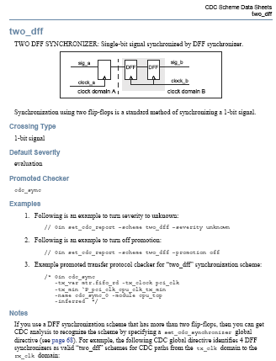
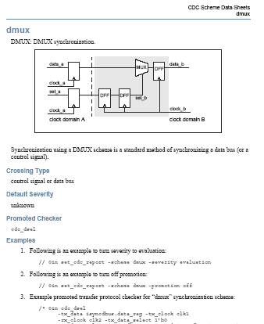
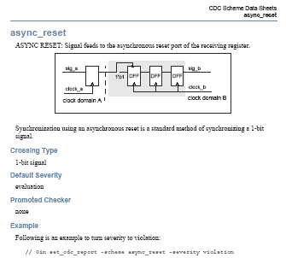
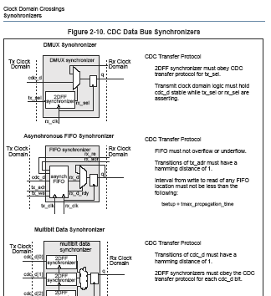
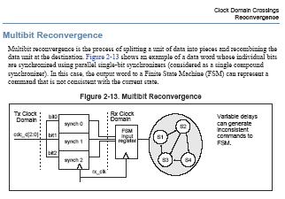
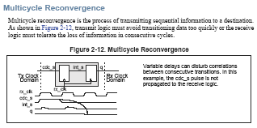
Wide Spectrum of Synchronizers for Solving Any CDC Issues
2DFF
DMUX
Handshake
FIFO
Asynchronous reset
… and more built-in …
< Customize your own >

Slide 30
Hierarchical CDC Analysis
Top-down flow
Top-level setups
Enables analysis of larger designs
Divide and conquer
Reduce memory footprint
Enables abstraction of block-level representation
Netlist model (gray box)
Interface only model (black box)
Enables parallel verification of multiple blocks
Reduce total time to verify the entire design
Safer, thorough approach that can find more bugs
Top
Propagate top-level setups
Block
Level
CDC
Block
Level
CDC
Block
Level
CDC
Block
Level
CDC
Block
Level
CDC
Top
Top-level checks
Integrated results
Bottom-up flow

Slide 31
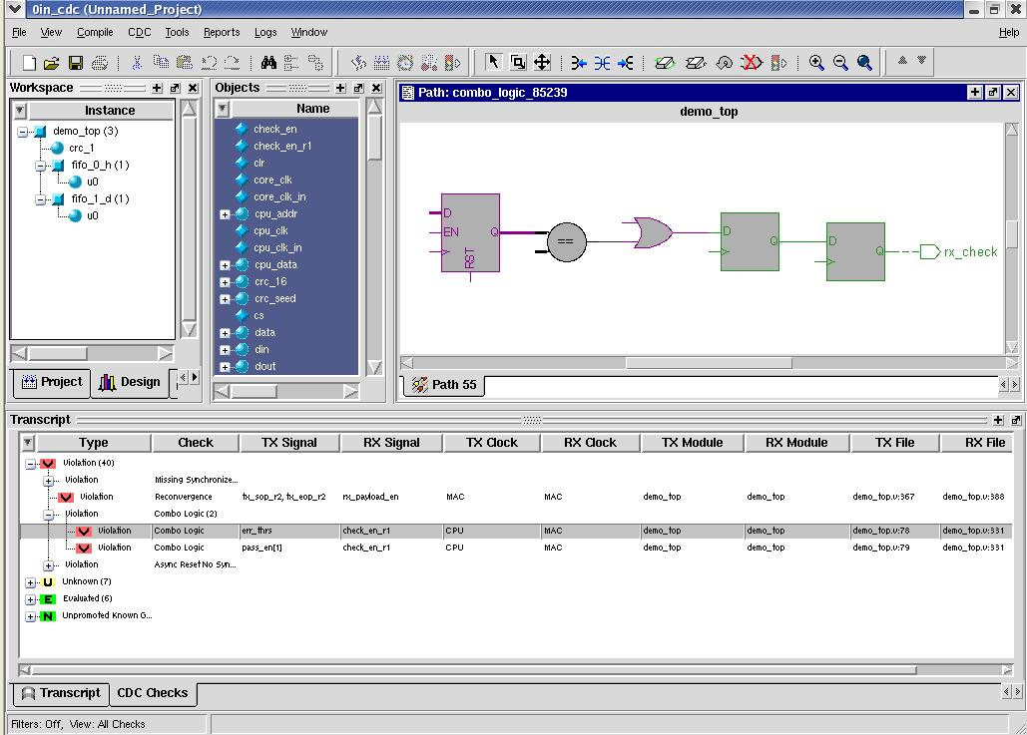
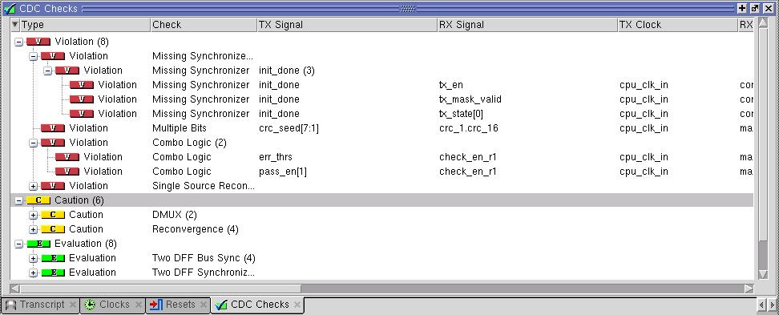
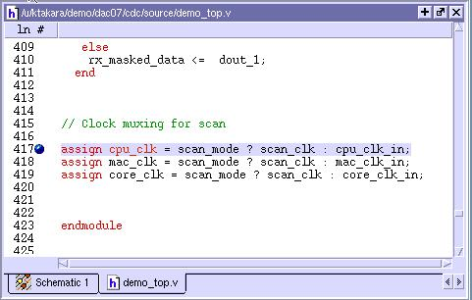
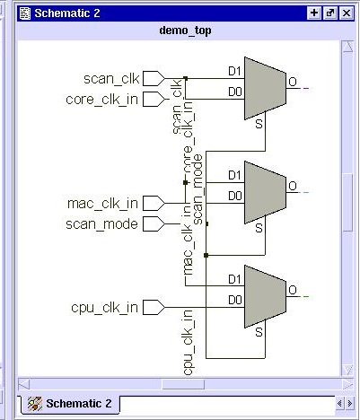
CDC Enhanced Reporting and Debugging
Provides a results overview window and details for all CDC issues
Automatically generates schematics for visualization of clock trees and CDC paths

Slide 32
Questa CDC Generates Automatic Protocol Checks
CDC protocols defined
Rules that ensure data is accurately transferred between two clock domains
Associated with specific synchronizer structures
The Questa CDC verification solution automatically generates assertions to capture these protocols
Seamless integration / transfer of generated assertions into Questa Formal or QuestaSim
Formal & simulation results are automatically correlated back to the source synchronizer for easy debug
(a) Mux select
(b) TX Data
(c) RX Data
Assertion
Protocol Example: When a transmitter's data select signal crosses a clock domain and drives the mux select input (a) of a data multiplexer in the receiver, it must be held stable long enough for the signal (b, TX Data) to be sampled reliably by the receiver (c, RX Data) and the data must remain stable while the data select signal asserts.

Slide 33
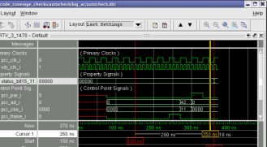
Questa CDC Protocol Assertion Flow
RTL
RTL
RTL &
Testbench
CDC Protocol Assertions
CDC Protocol Assertions
Questa Formal Analysis
Non-proven
Questa CDC
Static Analysis
Simulation
Proven Assertions
Formally prove CDC protocols are implemented correctly – fully automatic
Simulate CDC protocol assertions jointly with the design and testbench
Covered Assertions
Review Assertion Violations
Coverage Reporting

Slide 34

Questa CDC Protocol Verification Details
Automatic SVA protocol checker generation
Synchronizer-specific protocol assertion macros instantiated
Protocol checkers include assertions and coverage
Simulation generates CDC database
Assertion and coverage data captured during simulation
Formal CDC verification
Exhaustive protocol verification results through formal analysis
Automated formal verification setup
Integrated protocol results viewing
View protocol assertion and coverage results
Correlate protocol results with structural CDC results
Enables protocol verification closure
Coverage measures protocol verification progress and completeness
Identify and fix coverage holes

Slide 35
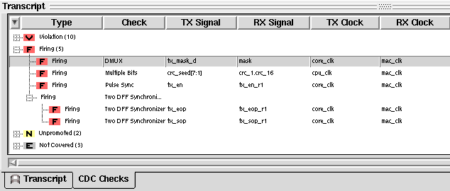
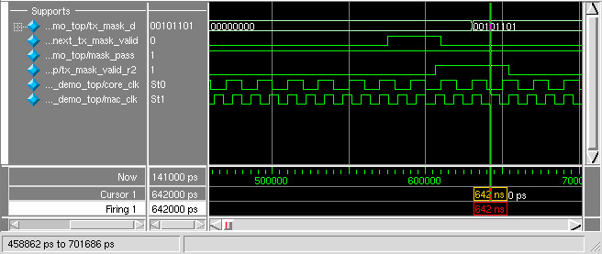
Questa CDC Driving Formal or Simulation-Based Protocol Verification
All CDC protocol violations are shown in CDC analysis window
Debug is performed in formal or simulation environment
Highlights exactly where a protocol violation occurs

Slide 36

Dynamic CDC Analysis for Verifying Resiliency
Simulation with “Behavioral Metastability Models” is the ONLY way to verify whether the design is resilient w.r.t. non-deterministic delays in synchronizers
Questa “CDC-FX” generates the models
Include metastability models in simulation to access impact of synchronizer choice
Setup violation
Tx
Rx
D
Q
D
Q
D
Q
Tx
clk_B
clk_A
2DFF Synchronizer
Rx
clk_B
Rx
Metastability Checker
Driver
i -1
i
i +1
i +2
i +3
Behavioral Metastability Model (BMM)

Slide 37
CDC Errors are Painful!
Usually not caught by simulation
Found late in the development cycle
Often only in silicon
Silicon failures are intermittent
Difficult to reproduce
Difficult to debug
Lot’s to consider:
Re-convergance
Protocol checking
Metastability

Slide 38
Questa CDC Summary The industry benchmark for CDC verification
All designs with multiple, asynchronous clock domains require a CDC verification solution to avoid costly bugs
Questa CDC offers:
The industry’s leading clock-domain crossing verification solution
Complete and accurate CDC reporting, protocol verification, and metastability modeling
A proven track record and an exacting hierarchical approach
Includes support for power-aware CDC analysis and functional simulation

